Slide 1
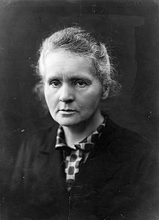
Marie Curie
Presentation by:-
111077 Sanat Pawar
111015 Sushant Dange
111045 Shardul Anaspure
111056 Shreerang Mhatre
111060 Aman Singh

Slide 2
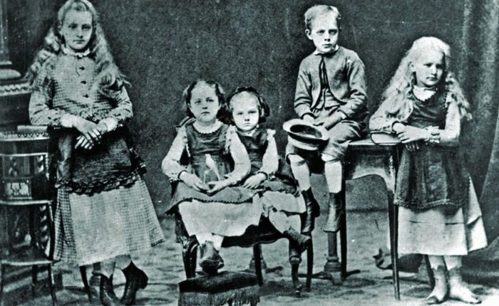
EARLY LIFE
Marie Curie grew up in Warsaw, Poland where she was born on November 7, 1867.
Her birth name was Maria Sklodowska, but her family called her Manya.
Her parents were both teachers. Her dad taught math and physics and her mom was headmistress at a girl's school.
Marie was the youngest of five children. Growing up the child of two teachers, Marie was taught to read and write early.

Slide 3
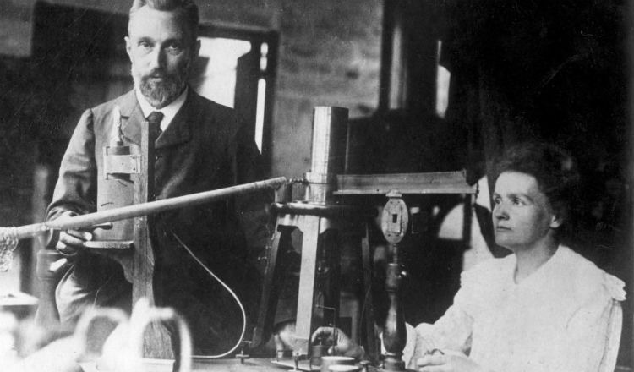
EDUCATION
She immediately entered Sorbonne University in Paris where she read physics and mathematics – she had naturally discovered a love of the subjects through her insatiable appetite for learning.
She finished her studies on 1883.
She wanted to study at Sorbonne university.
To prepare, she joined the "flying university".
To prepare for the Sorbonne she got a job as a governess.

Slide 4
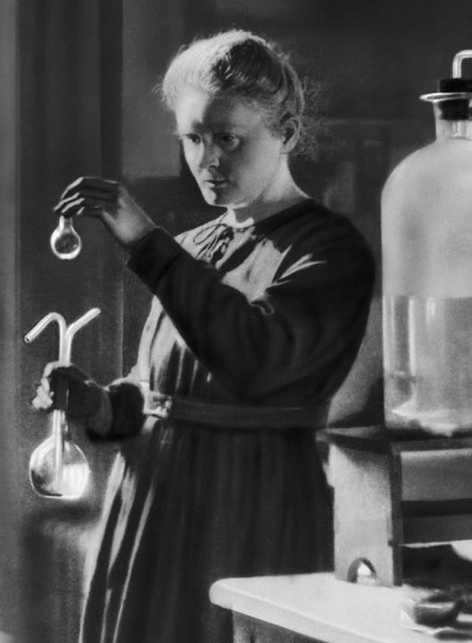
RESEARCH AREA
MARIE CURIE'S CHOICE of a thesis topic was influenced by two recent discoveries by other scientists.
In December 1895, about six months after the Curies married, German physicist Wilhelm Roentgen discovered a kind of ray that could travel through solid wood or flesh and yield photographs of living people's bones.
Roentgen dubbed these mysterious rays X-rays, with X standing for unknown. In recognition of his discovery, Roentgen in 1901 became the first Nobel laureate in physics.

Slide 5
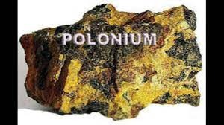
POLONIUM
Marie discovered that there was something going on inside the atom that created the rays, she named this effect "radioactivity".
Pierre stopped his work on crystals to work with Marie.Marie continued her work, but with a different substance, pitchblende.
In July 1898 they extracted a new element that was even more radioactive than uranium.
They called this new substance polonium in honor of Marie's homeland.

Slide 6
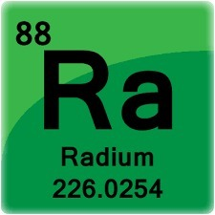
RADIUM
In January of 1899 another new element was discovered that was over 1 million times more radioactive than uranium, it was named radium.
Her major studies showed that radium gave out light and heat, as well as being able to damage living flesh.
In order to obtain one decigram of pure radium chloride salt, Marie had to sift through hundreds of tons of pitchblende.
Today it is used in small amounts as a cancer treatment and in fluorescent paint

Slide 7
Achievements
Marie in the work that she had undertaken to resolve this problem and that led to the discovery of the new elements, polonium and radium. Pierre devoted himself chiefly to the physical study of the new radiations. In 1902 Marie succeeded in isolating one-tenth of a gram of radium chloride that was entirely free from barium.
1903 Marie , Pierre, and Becquerel shared the Nobel Prize in Physics. Marie was the first woman to win the Nobel Prize in any subject. Pure radium alone was not isolated until 1910 by Marie with the help of chemist André-Louis Debierne, one of Pierre’s pupils.

Slide 8
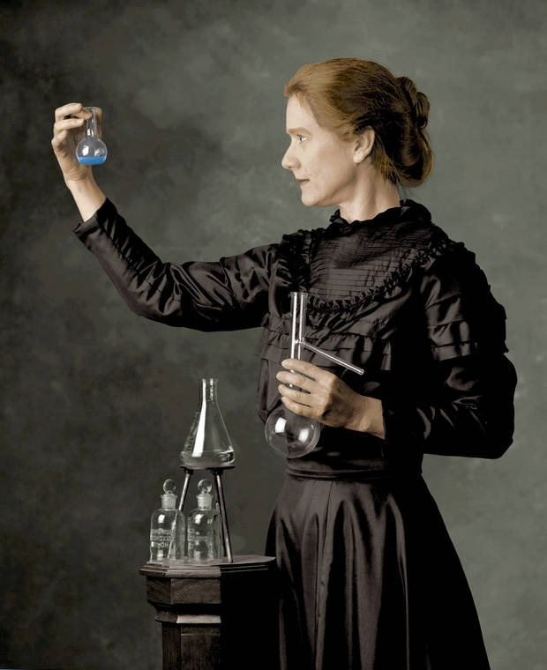
Achievements
The radioactivity of pure radium proved to be more than one million times as great as that of either uranium or thorium. In 1911 Marie was awarded the Nobel Prize for Chemistry, for the isolation of pure radium.
She learned human anatomy and X-ray machine operation and taught these to others.

Slide 9
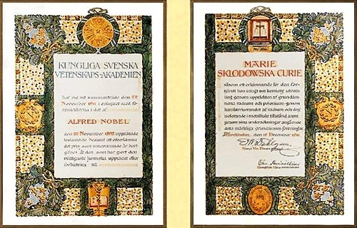
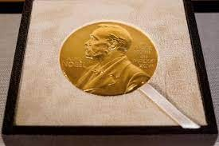
AWARDS
Nobel Prize in Physics (1903) Davy Medal (1903) Matteucci Medal (1904) Actonian Prize (1907) Elliott Cresson Medal (1909) Albert Medal (1910) Nobel Prize in Chemistry (1911) Willard Gibbs Award (1921) Cameron Prize for Therapeutics of the University of Edinburgh (1931)

Slide 10
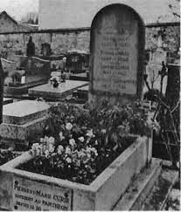
AFTER LIFE
Curie visited Poland for the last time in early 1934. A few months later, on 4 July 1934, she died aged 66 at the Sancellemoz sanatorium in Passy, Haute-Savoie, from a plastic anemia believed to have been contracted from her long-term exposure to radiation, causing damage to her bone marrow.

Slide 11
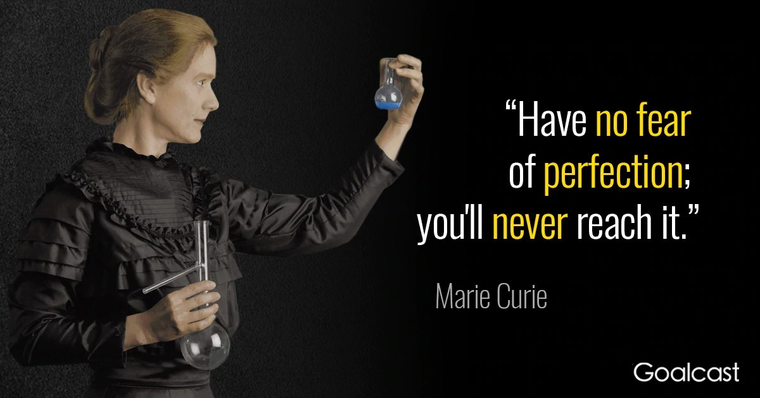

Slide 12
REFRENCE
https://en.wikipedia.org/wiki/Marie_Curie
https://www.britannica.com/biography/Marie-Curie
https://www.nobelprize.org/prizes/physics/1903/marie-curie/biographical/
https://www.mariecurie.org.uk/who/our-history/marie-curie-the-scientist

Slide 13
THANK YOU

